Slide 1
Compare auto& manual alignment in python
applyMapping_v3basic.py
Pick_spots_akaze_manual.py (&final)

Slide 2
transform_matrix_AUTO
array([[ 9.57285865e-01, -1.15950413e-02, 5.18576164e+00],
[-4.42637824e-02, 9.50632953e-01, 4.70439692e+00],
[-1.40070594e-04, -4.15501537e-05, 1.00000000e+00]])
transform_matrix_MANUAL
array([[ 1.01259741e+00, 3.96377052e-03, -2.93740313e+00],
[ 1.22886094e-02, 9.99796913e-01, -8.05862291e+00],
[ 3.68368855e-05, -3.68545569e-06, 1.00000000e+00]])

Slide 3
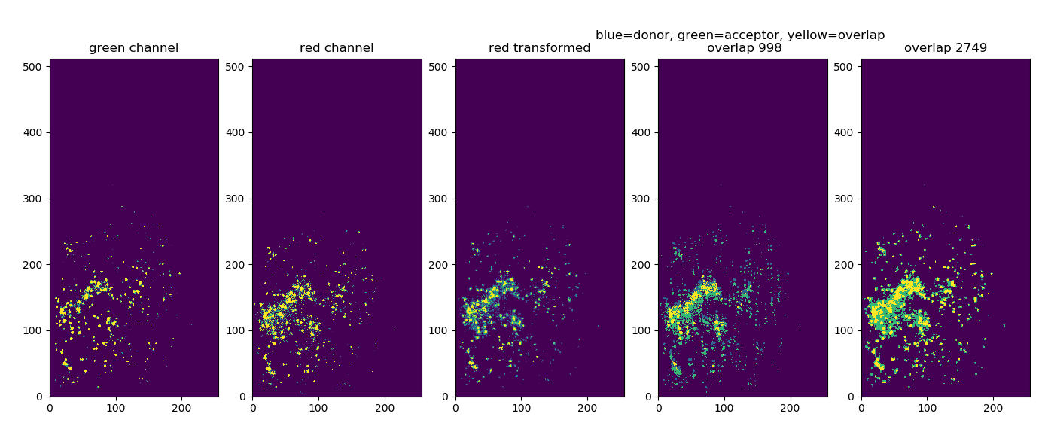
AUTO align

Slide 4
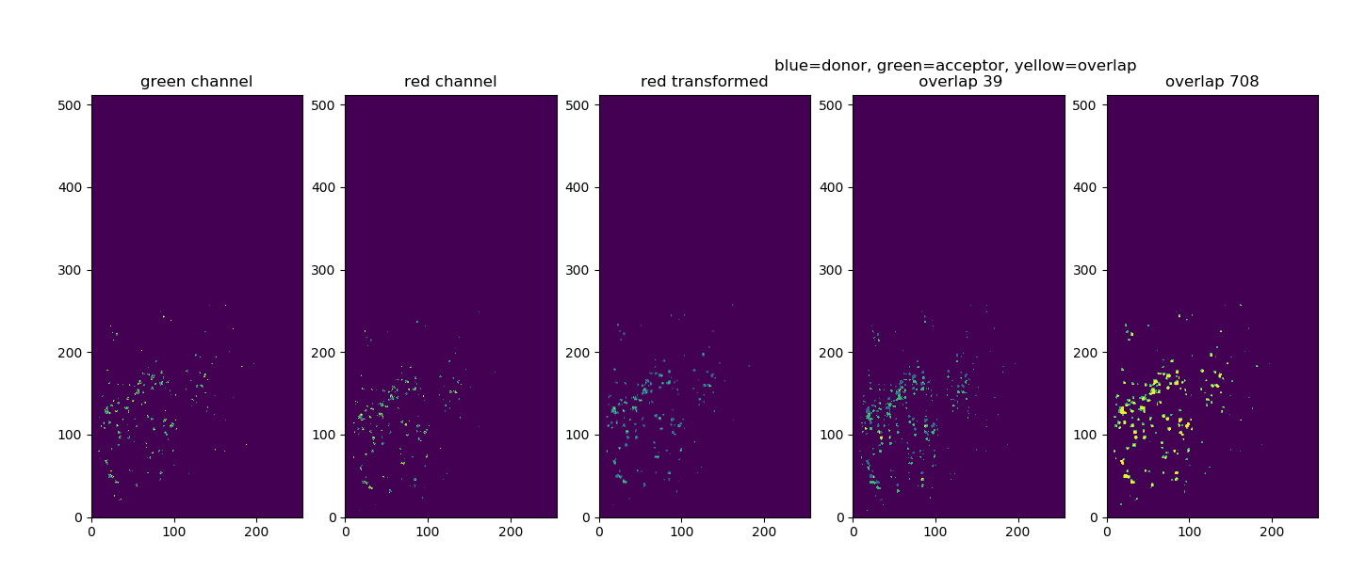
MANUAL align

Slide 5
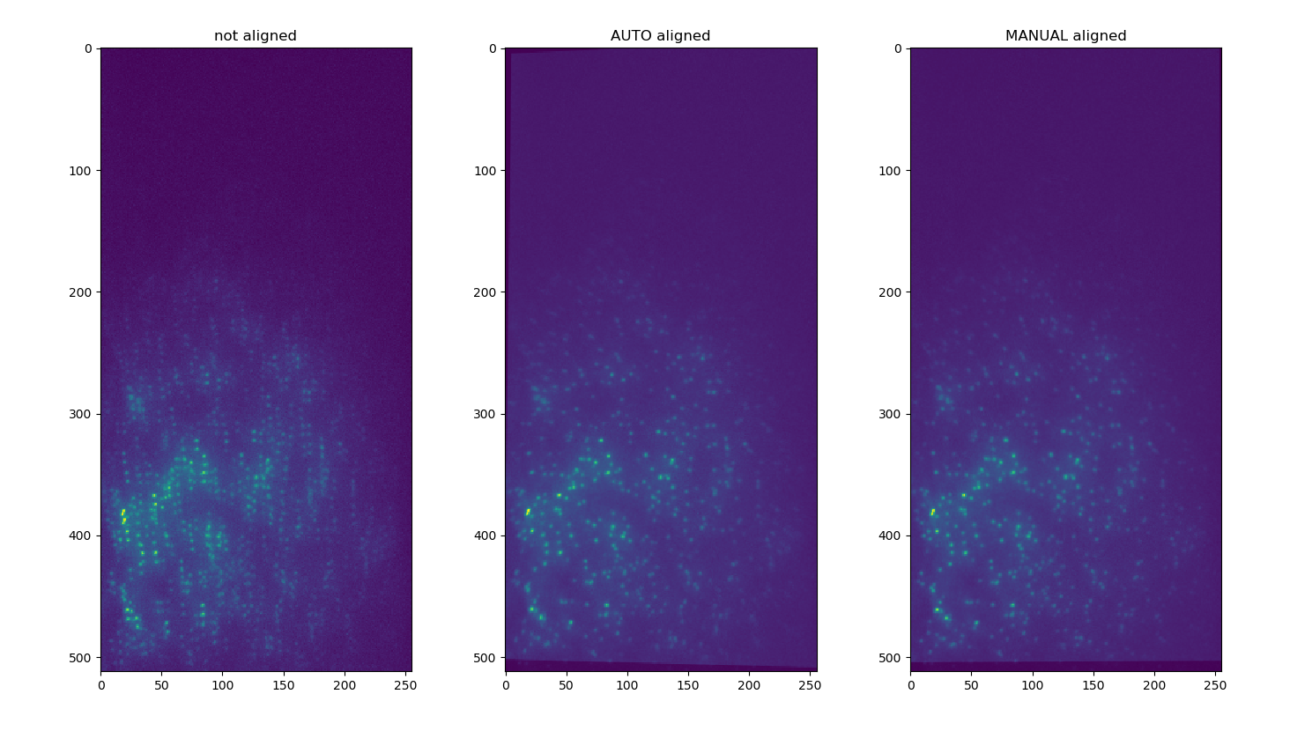
compare

